Slide 1
Group 1 Assignment
Modems & RS-232 Interfacing Sequences
and Line Coding & Its Techniques
CIT 3212 — Computer Networks
Topic area: The Physical Layer (OSI Layer 1)
Prepared in answer to “Assignment on Physical Layer (Group 1)”
Notes:
Title slide. Introduce the two assignment parts: modems/RS-232 and line coding.

Slide 2
Outline
2
• 1. Introduction — Physical Layer context
• 2. Modems — purpose & operation
• 3. Modem types & modulation techniques
• 4. RS-232 — interface & voltage levels
• 5. RS-232 pin-out & handshaking sequence
• 6. Line coding — definition & design goals
• 7. Line coding schemes & waveforms
• 8. Worked example & comparison
• 9. Summary
Where this fits
Both topics live in the Physical Layer (Layer 1).
Modems/RS-232 = how two devices exchange data.
Line coding = how bits become a signal.
Notes:
Roadmap of the presentation.

Slide 3
1. Introduction
3
Both parts of this assignment belong to the Physical Layer (Layer 1) of the OSI model — the layer that moves raw bits across a transmission medium.
Modems & RS-232
Modem converts digital data into signals suitable for a line.
RS-232 defines the electrical + procedural interface between a computer and a modem/serial device.
Together: how data is carried between two devices.
Line Coding
Converts a sequence of bits into a digital signal.
Placed directly on the baseband medium.
Concerned with signal shape, synchronisation and DC.
Happens before carrier modulation.
Notes:
Set the scene: layer 1 responsibilities.

Slide 4
2. Modems — Definition & Purpose
4
A modem (MOdulator–DEModulator) converts digital data from a computer into an analogue signal for transmission over a line, and converts received analogue signals back into digital data.
• Modulation — sender changes a carrier wave to represent 0s and 1s.
• Demodulation — receiver extracts the original bits from the carrier.
• Most modems are full-duplex: modulate and demodulate simultaneously.
• Classic Layer-1 device; bridges digital computers and analogue media.
• Carrier is a sine wave whose amplitude, frequency or phase can be varied.
Notes:
Explain the acronym and the digital/analogue mismatch it solves.

Slide 5
2. How a Modem Works
5
1
Bits from the computer arrive over the serial interface (RS-232).
2
The modulator impresses the bits on a carrier (ASK/FSK/PSK/QAM).
3
The analogue signal travels over the transmission line.
4
The far-end demodulator recovers the bits from the carrier.
5
Bits are passed to the receiving computer via its serial interface.
Notes:
Real-world illustration of how a modem connects to a computer via the RS-232 serial interface.

Slide 6
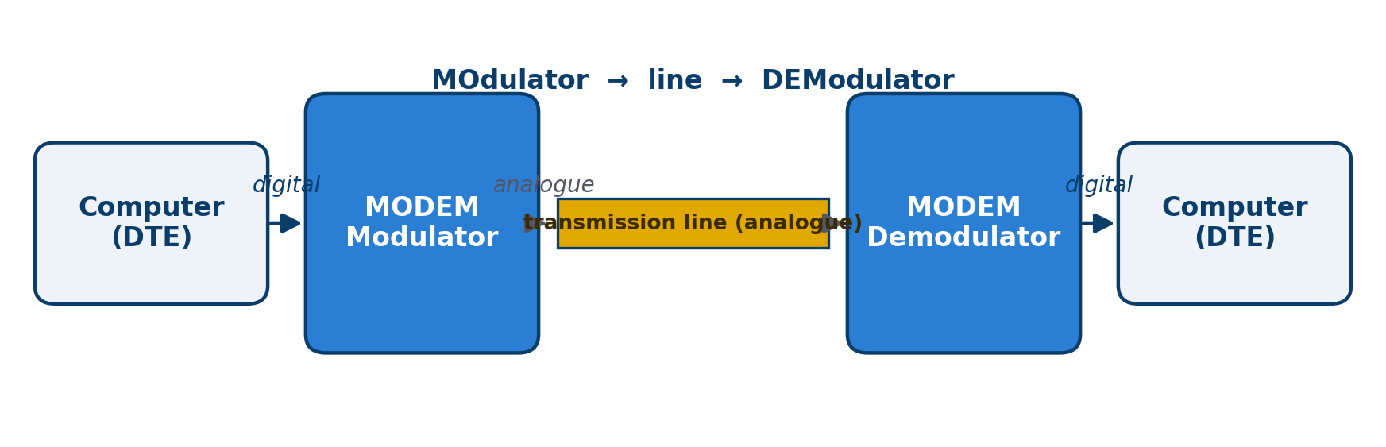
2. Modem — Block Diagram
6
Digital data is modulated onto the line and demodulated at the far end.
CIT 3212 — Computer Networks | Group 1 Assignment

Slide 7
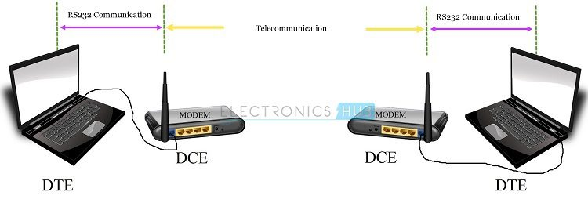
2. Modem — RS-232 to Laptop (Example)
7
A laptop connected to a modem through an RS-232 serial cable.
CIT 3212 — Computer Networks | Group 1 Assignment

Slide 8
3. Types of Modems
8
By | Type | Description
Direction | Half-duplex | Both directions, but not at the same time
Direction | Full-duplex | Both directions simultaneously
Medium | Dial-up (PSTN) | Ordinary phone lines; up to 56 kbps
Medium | DSL / ADSL | High-speed data over phone lines, voice unaffected
Medium | Cable modem | Data over cable-TV (coaxial) networks
Connection | Internal / External | Expansion card / separate box via serial cable
Carrier | Wireless / cellular | Uses radio (GSM / 4G / 5G)
Notes:
Classify modems by direction, medium, connection and carrier.

Slide 9
3. Modulation Techniques
9
ASK — Amplitude Shift Keying
Carrier amplitude switched between levels.
FSK — Frequency Shift Keying
Different frequencies represent the bits.
PSK — Phase Shift Keying
Carrier phase is shifted to encode bits.
QAM — Quadrature Amplitude Modulation
Amplitude + phase combined; many bits per symbol.
bit rate = baud rate × bits per symbol
Notes:
Visual comparison of the three basic digital modulation schemes.

Slide 10
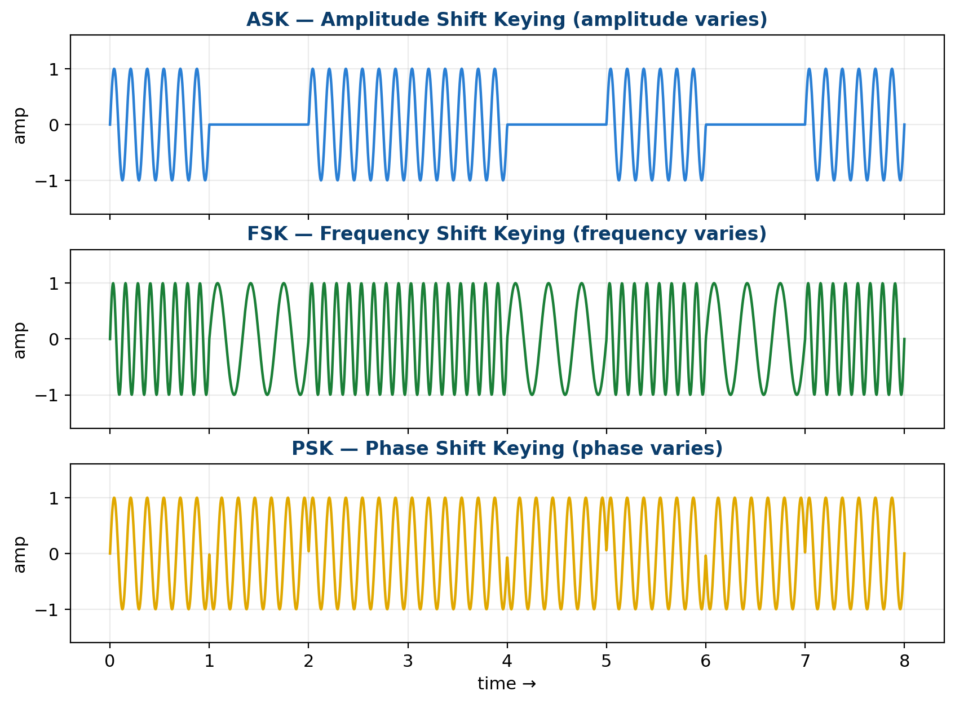
3. Modulation Waveforms (ASK / FSK / PSK)
10
Data bits 1 0 1 1 0 1 0 1 encoded by changing amplitude, frequency or phase.
CIT 3212 — Computer Networks | Group 1 Assignment

Slide 11
4. RS-232 — What It Is
11
RS-232 (Recommended Standard 232 / EIA-232) is a standard for serial binary data interchange between Data Terminal Equipment (DTE) and Data Communication Equipment (DCE) over a single-ended, point-to-point link.
It defines three things
Electrical — voltage levels and signalling.
Mechanical — connectors (DB-9 / DB-25) and pin-outs.
Procedural — the sequence of control signals.
DTE vs DCE
DTE = Data Terminal Equipment (computer / terminal).
DCE = Data Communication Equipment (modem).
The interface lets the DTE talk to the DCE.
Notes:
Emphasise electrical, mechanical and procedural scope.

Slide 12
4. RS-232 — Electrical Characteristics
12
Logic | Signal | Voltage at transmitter
0 (Space) | ON / active | +3 V to +15 V (typ. +12 V)
1 (Mark) | OFF / idle | −3 V to −15 V (typ. −12 V)
• Negative logic — large voltage swings resist noise.
• Voltages between −3 V and +3 V are undefined (rejected as noise).
• Maximum cable length ≈ 15 m (50 ft) at 19.2 kbps.
• Common data rates up to 20 kbps (115.2 kbps over short cables).
• Single-ended (unbalanced) signalling → limited noise immunity vs RS-422/RS-485.
Notes:
Stress negative logic and the ±3 V noise margin.

Slide 13
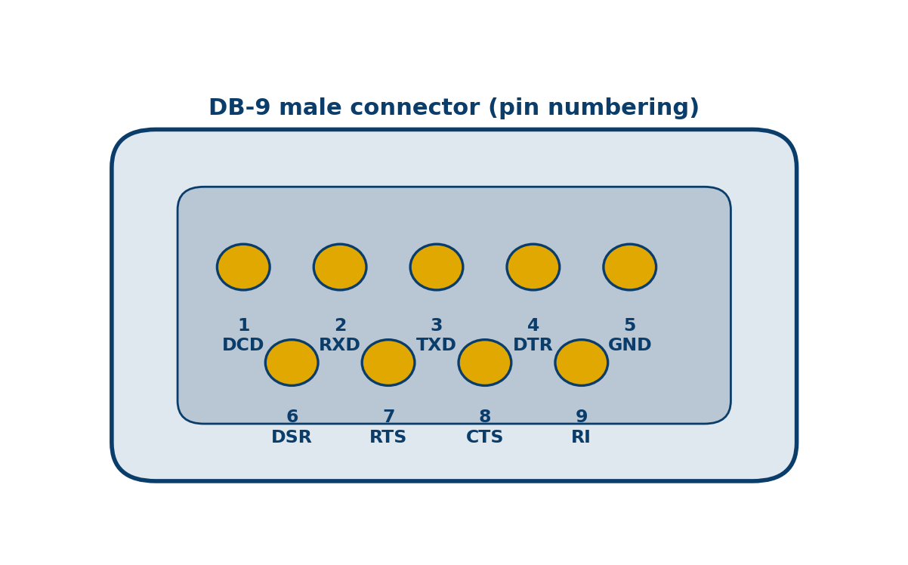
4. RS-232 — Pin-Out (DB-9)
13
Pin | Name | Dir. | Function
1 | DCD — Carrier Detect | DCE→DTE | Carrier detected
2 | RXD — Receive Data | DCE→DTE | Data received
3 | TXD — Transmit Data | DTE→DCE | Data sent
4 | DTR — Terminal Ready | DTE→DCE | Computer ready
5 | GND — Signal Ground | — | Common reference
6 | DSR — Data Set Ready | DCE→DTE | Modem ready
7 | RTS — Request To Send | DTE→DCE | Ask to send
8 | CTS — Clear To Send | DCE→DTE | Permission to send
9 | RI — Ring Indicator | DCE→DTE | Incoming call
Three signal pairs: TXD/RXD (data), DTR/DSR (readiness), RTS/CTS (flow).
Notes:
Highlight the three signal pairs: TXD/RXD, DTR/DSR, RTS/CTS.

Slide 14
5. RS-232 Handshaking Sequence
14
1
DTE asserts DTR — Computer: “I am on and ready.”
2
DCE asserts DSR — Modem: “I am on and ready.”
3
DTE asserts RTS — Computer: “I want to send data.”
4
DCE asserts CTS — Modem: “Go ahead, send.” → data on TXD
5
Data exchange — TXD (send) / RXD (receive)
6
DTE drops RTS — Computer: “I have finished sending.”
7
DCE drops CTS — Modem: “Acknowledged.”
8
Drop DTR/DSR — Connection released.
Notes:
Timing view of DTR/DSR then RTS/CTS, then data.

Slide 15
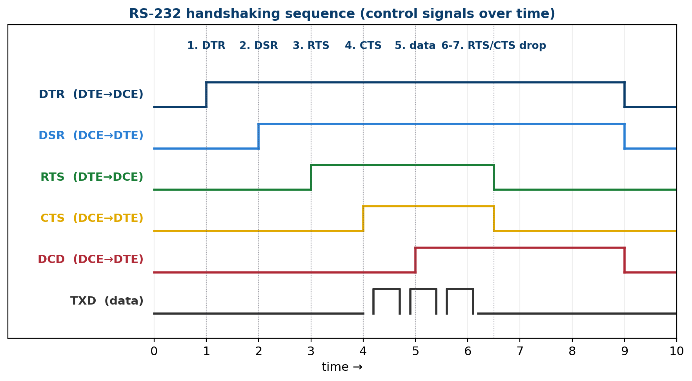
5. RS-232 Handshake — Timing Diagram
15
Control signals are asserted in order before data flows on TXD.
CIT 3212 — Computer Networks | Group 1 Assignment

Slide 16
5. Flow Control, Null Modem & Limitations
16
Flow control
Hardware (RTS/CTS): receiver lowers CTS to pause the sender.
Software (XON/XOFF): Ctrl-Q / Ctrl-S characters in the data stream.
Null modem
Connects two DTE devices directly.
Crosses TXD↔RXD and RTS↔CTS.
Often loops DTR↔DSR — no modem needed.
Limitations of RS-232
Short distance (≈15 m) and low speed.
Single-ended signalling → poor noise immunity.
Point-to-point only; bulky cables and large voltage swings.
Largely replaced by USB and differential standards (RS-485), still used in embedded/industrial devices.
Notes:
Cover flow control, null modem wiring and the practical limits.

Slide 17
6. Line Coding — Definition & Goals
17
Line coding is the process of converting a sequence of bits into a digital signal that can be transmitted over a baseband channel — mapping 1s and 0s to voltage or current levels.
Design goal | Meaning
No DC / baseline | Avoid drifting average voltage that confuses the receiver
Self-synchronisation | Enough transitions for the receiver to recover the clock
Error detection | Some codes can detect errors
Noise immunity | Resistance to interference on the line
Bandwidth efficiency | Use minimal bandwidth for a given data rate
Notes:
Line coding turns bits into a waveform; happens before carrier modulation.

Slide 18
7. Line Coding Schemes
18
Unipolar
Levels on one side of the axis.
Unipolar NRZ: 1 = +V, 0 = 0 V.
Simple, but DC component + poor sync.
Polar
Uses positive and negative voltages.
NRZ-L: level = bit value.
NRZ-I: 1 = transition, 0 = no change.
RZ, Manchester, Differential Manchester.
Bipolar
Three levels: +, 0, −.
AMI: 0 = 0 V; 1s alternate polarity.
Pseudoternary swaps the roles.
No DC, good bandwidth efficiency.
Block coding & scrambling
Block: m bits → n bits (4B/5B, 8B/10B).
Guarantees transitions, removes DC.
Scrambling: B8ZS, HDB3 for long distance.
Notes:
NRZ-L follows the level; NRZ-I follows transitions; Manchester always transitions mid-bit; AMI alternates polarity on 1s.

Slide 19
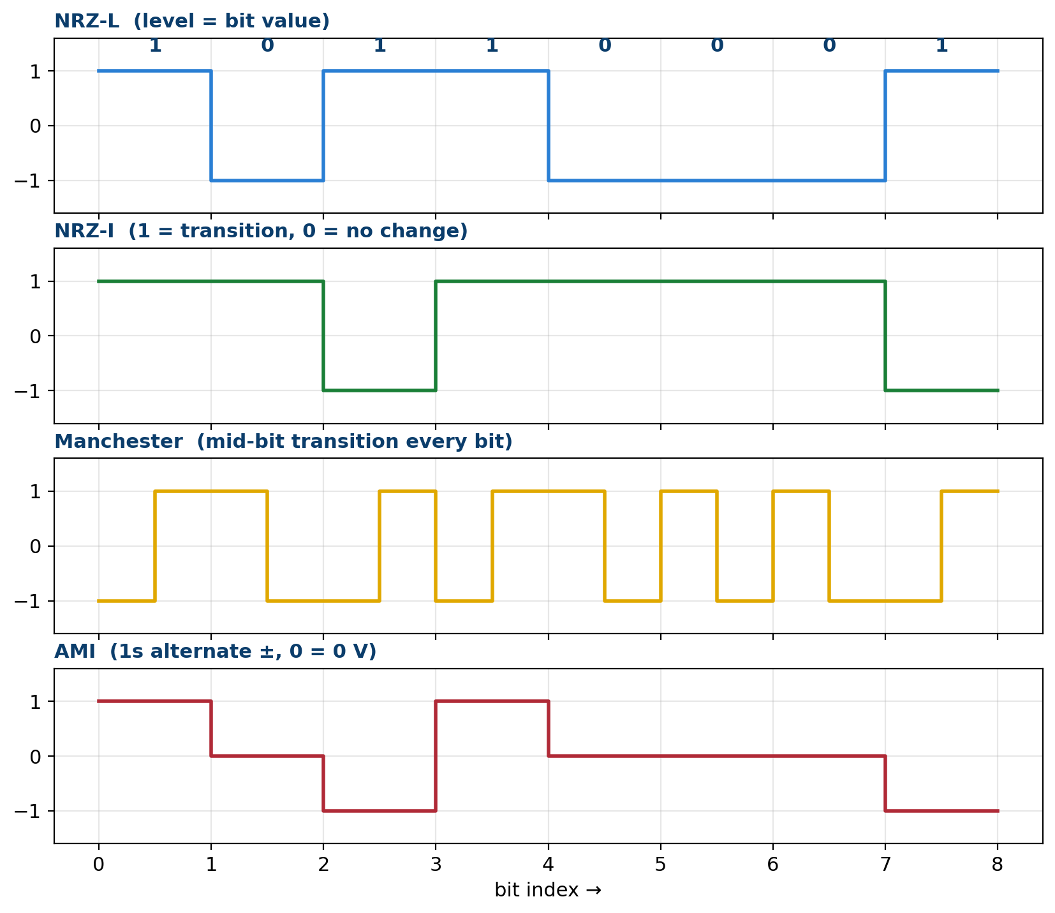
7. Line Coding Waveforms
19
Same data bits (1 0 1 1 0 0 0 1) encoded with four different schemes.
CIT 3212 — Computer Networks | Group 1 Assignment

Slide 20
8. Worked Example
20
Data bits: 1 0 1 1 0 0 0 1
NRZ-L : + - + + - - - +
NRZ-I : + + - + + + + - (1 = transition, 0 = no change)
Manchester : every bit has a mid-bit transition
AMI : + 0 - + 0 0 0 - (1s alternate, 0 = 0 V)
Remember: NRZ-L follows the level • NRZ-I follows transitions • Manchester always has a mid-bit transition • AMI alternates polarity on 1s.
Notes:
See the previous waveform slide for the visual of this same data byte.

Slide 21
8. Comparison of Line Coding Schemes
21
Scheme | Levels | DC | Self-sync | Bandwidth | Typical use
Unipolar NRZ | 2 | Yes | No | Low | Simple / legacy
NRZ-L | 2 | Possible | No | Low | General digital
NRZ-I | 2 | Possible | Partly | Low | USB, Fast Ethernet
RZ | 3 | No | Yes | High (2×) | Legacy
Manchester | 2 | No | Yes | High | 10Base-T Ethernet
Diff. Manchester | 2 | No | Yes | High | Token Ring
AMI | 3 | No | Partly | Moderate | T1 lines
4B/5B + NRZ-I | 2 | No | Yes | Moderate | 100Base-FX
Notes:
Summarise trade-offs across the schemes.

Slide 22
9. Summary
22
Modems
Convert digital ↔ analogue using ASK, FSK, PSK or QAM over lines such as telephone/cable.
RS-232
Serial DTE–DCE interface: voltage levels, DB-9/DB-25 pin-out, handshaking (DTR/DSR, RTS/CTS, DCD, RI).
Line coding
Turns bits into a digital signal. Good codes: no DC, self-synchronising, noise-resistant.
Families: unipolar, polar (NRZ/RZ/Manchester), bipolar (AMI), block coding (4B/5B), scrambling (B8ZS, HDB3).
Notes:
Recap the three themes.

Slide 23
Thank You
Questions & Discussion
Group 1 — CIT 3212 Computer Networks
Notes:
Close and invite questions.

